Slide 1

Entrepreneurship Basics
VX 420: Week 1 Lecture
Introduction

Slide 2
Agenda
What is “entrepreneurship”?
Why be an entrepreneur? Why not?
Why should you be interested in this class?

Slide 3
QUESTION #1
What is entrepreneurship?
Can we define it?
What do you think?

Slide 4
Some Modern Definitions
Scott Shane (Case Western) – “Entrepreneurship is an activity that involves the discovery, evaluation and exploitation of opportunities to introduce new goods and services, ways of organizing, markets, processes, and new materials through organizing efforts that previously had not existed.”
Howard Stevenson (Harvard) – “.. The pursuit of opportunity without regard to resources currently controlled.”
W. Gibb Dyer, Jr. (BYU) – “The founding of new businesses is the essence of entrepreneurial activity.”

Slide 5
Frank Knight (1885-1972)
Entrepreneur has a two-fold function
  Exercising responsible control (directing the work of others)
  Securing the owners of productive services against uncertainty and fluctuations in their incomes
Distinguished between risk, which is insurable, and uncertainty, which is not
  Uncertainty includes things like changes affecting the marketing of consumer products (e.g., fashion trends)
Profit compensates entrepreneur for bearing uncertainty

Slide 6
Joseph Schumpeter (1883-1950)
(1934) - “implements change (‘creative destruction’) within markets through the carrying out of new combinations”.
(1942) – The entrepreneurial function “does not essentially consist in either inventing anything or otherwise creating the conditions which the enterprise exploits. It consists in getting things done.”
A lot of what an entrepreneur does on a day-to-day basis is not “entrepreneurial”

Slide 7
A Definition
Entrepreneurship seeks to understand how opportunities to create something new arise and are discovered or created by specific persons who then use various means to exploit or develop them, thus producing a wide range of effects.

Slide 8
Synthesis of “Entrepreneurship”
In general, even entrepreneurship researchers can’t agree on what the “best” definition of entrepreneurship is
Two main camps
  Discovery, evaluation, and exploitation of opportunities
  Starting new businesses

Slide 9
Synthesis of “Entrepreneurship”
Previous economists do a nice job defining entrepreneurship
  Concerned with decisions surrounding new profit opportunities
  Concerned with assembling resources
  All in the midst of uncertainty
But they don’t address who is likely to be an entrepreneur, or even more important, a successful entrepreneur

Slide 10
The Economic View of the Entrepreneurial Decision
access to
resources
other job
opportunities
ability to
organize
resources
specialized
skills
knowledge
entrepreneurship
orientation
Expected
Performance
≥
Performance
Threshold
Source: Gimeno, Folta, Cooper, & Woo (1997). “Survival of the fittest? Entrepreneurial human capital and the persistence of
underperforming firms”. Administrative Science Quarterly, 42: 750-783.

Slide 11
Job generation
Large firms add and tend to cut back with the business cycle.
In most business cycles, small firms add relatively higher percentage of total net new jobs during the recession phase.
  During the decade of the 1980’s, the Fortune 1000 cut 3.5 million jobs
  During the same period, small firms added 10 million jobs
  In 2001, new firm births declined 5.0% and closures rose 4.5%
  the fraction of employment accounted for by business startups in the U.S. private sector over the 1980-2005 period is about 3 percent per year. This exceeds the 1.8 percent average annual net employment growth. This pattern implies that job destruction exceeds job creation at existing businesses and highlights the importance of business startups for job creation in the U.S. economy

Slide 12
Entrepreneurship is a Multi-step Process
Recognize
Opportunities
Evaluate
Exploit
See also Amar Bhide’s article “The Questions Every Entrepreneur Must Answer” in case packet.

Slide 13
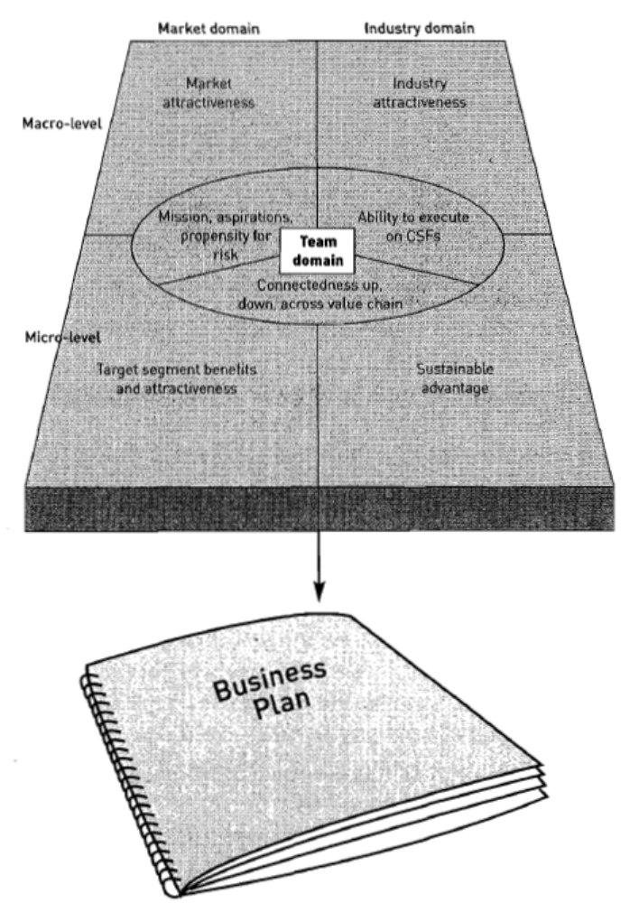
Market Attractiveness
Industry
Attractiveness
Mission
Aspiration
Propensity for Risk
Ability to Execute
On CSFs
Value Chain Connectedness
Target Segment Value Created
Sustainable
Advantage

Slide 14
QUESTION #2
Why be an entrepreneur?
What do you think?

Slide 15
Why should you be interested?
Many young people have succeeded:
  Michael Dell - Dell Computers
  Frank Carney - Pizza Hut
  Paul Orfalea - Kinko’s
  Fred DeLuca - Subway.
  Kristy Taylor - SkinCareRx.com
Opportunity to reap large profits

Slide 16
Why should you be interested? (cont.)
Available Resources
  Many are waiting for you to ask for help.
  Take advantage of your “harmless” appearance
Opportunity to control own destiny
Opportunity to reach your full potential
Opportunity to make a difference
  With employees – Jim Dodson, The Dodson Group
  With social concerns – Steve Row, Sun Garden Furniture

Slide 17
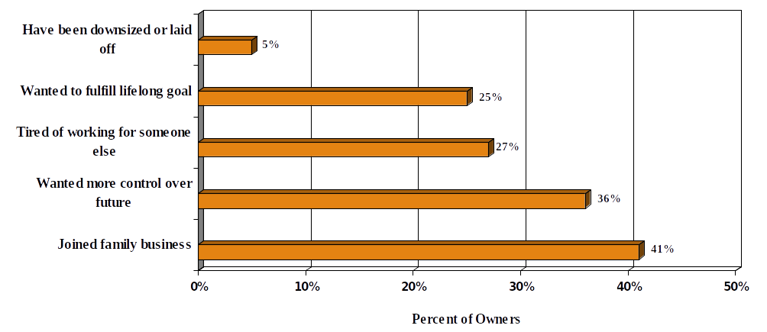
Source: Dun & Bradstreet 19th Annual Small Business Survey, 2000

Slide 18
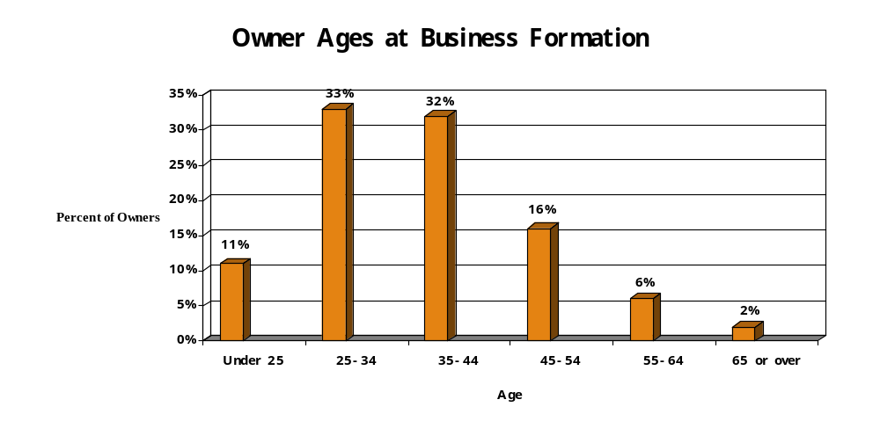
Sources: National Federation of Independent Business and Wells Fargo Bank

Slide 19
Why NOT to be an Entrepreneur
Uncertainty of income
Risk of losing entire invested capital
Lower quality of life until business gets established
High levels of stress
Complete responsibility

Slide 20
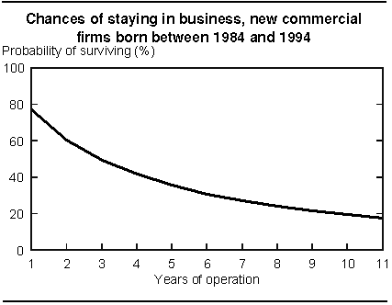
New Firm Survival Rates
According to Dun & Bradstreet study of businesses between 1989-1992:
  66% of businesses remain open at least 2 years.
  50% remain open at least 4 years.
  40% remain open at least 6 years.
Study of Canadian firms found roughly the same:

Slide 21

Intrapreneurs
Persons who create something new, but inside an existing company rather than through a new venture.

Slide 22
Trend toward Entrepreneurship
Media accounts of success
Change in “employment contract”
Change in basic values

Slide 23

Key Activities
Identifying an opportunity
Exploiting or developing this opportunity
Running a new business successfully

Slide 24
Foundations in Other Disciplines
Economics
Technology
Psychology, cognitive science
Behavioral science
Business and finance
Law
Sociology
Political science

Slide 25

Macro and Micro
Micro perspective—focuses on the behavior and thoughts of individuals (career goals)
Macro perspective—focuses primarily on environmental factors (e.g., Incubators)
Both are key in understanding the entrepreneurial process

Slide 26
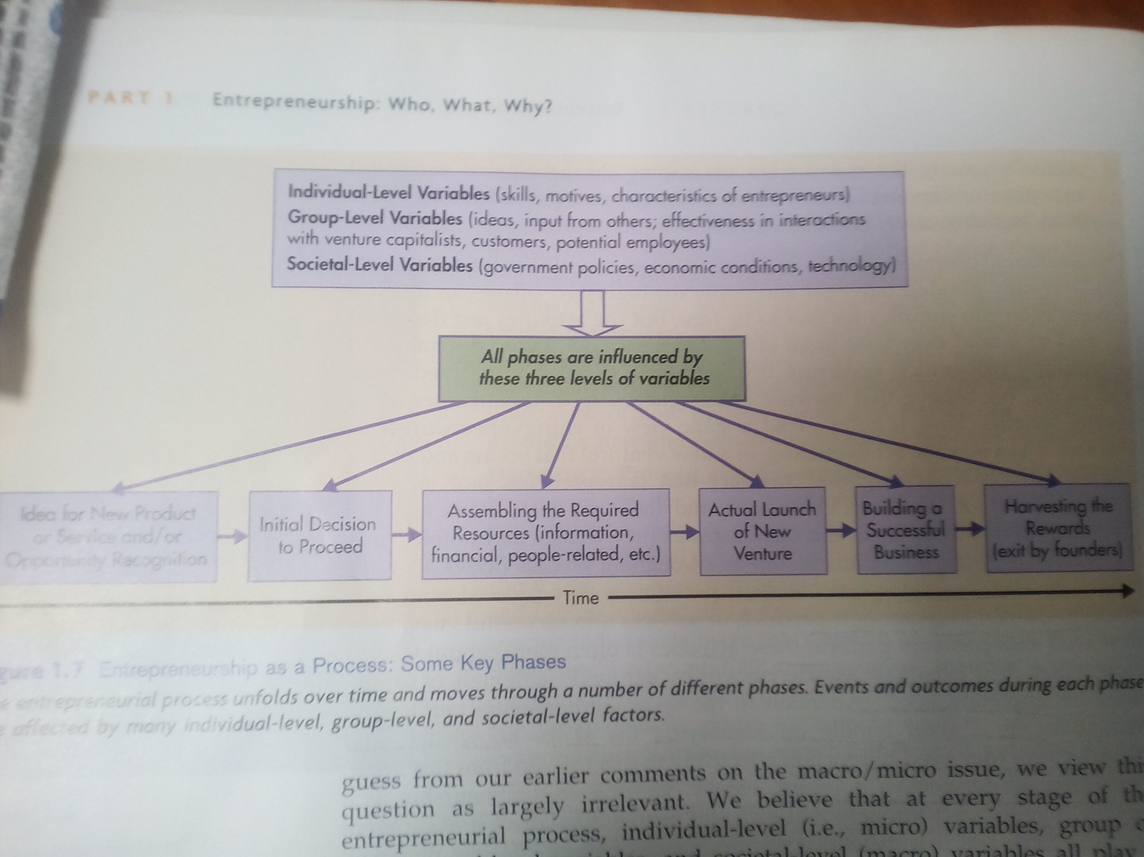

Slide 27
The Process
Recognition of an opportunity
Deciding to proceed and assembling resources
Launching a new venture
Building success
Harvesting the rewards

Slide 28

A Confluence of Factors
Social
Change
New
Markets
Opportunity
Economic
Change
Technology

Slide 29
To Do Good
Entrepreneur’s products and services improve the lives of countless millions of persons
Entrepreneurs are often extremely generous in their donations to worthy causes

Slide 30
Generational Demographics
DOB | Age | Defining Event | Consequence | + Characteristics | - Characteristic
1948- | 60 50 | Cultural Revolution | No/low university education | Ethical, pragmatic | Unsophisticated
1959- | 49 39 | Open Door Policy | Experienced struggle | Tough, hard working | Not international
1970- | 38 28 | Spectacular Rise of China | Expects automatic success | Educated, bi-lingual, global | Cocky
1981- | 27 17 | One Child Policy | Spoiled, focus of family pressure | Career focused, globally astute | Weak social skills
1992-2002 | 16 6 | 2008 Olympics | Electronics/Media/ Material addicted | Wide open to the whole world | Overwhelmed (by expectations)

Slide 31
Opportunity Benefits Summary
Gov’t favorite #1: Emerging West (Sichuan, ChongQing, NE, …)
Gov’t favorite #2: “Green” power, conservation, substitution
Ignored markets: 2nd tier of over 100 cities > 1 million people
Sell to the SOE’s (e.g., training – ISO, Deming, Finance, Law …)
Manage “trust” for speed and risk-capital benefits
Use “trust” instead of plans, projections, and contracts
Make universities a connections hub (copy Obama)
Tap the frustrated unemployed, talented, college graduates
Convert the enormous savings into something very secure
Alleviate the pressures or shortcomings of the Generations
Sell future success of the kids, each has 6 parents to buy/pay
COVID-19

Slide 32
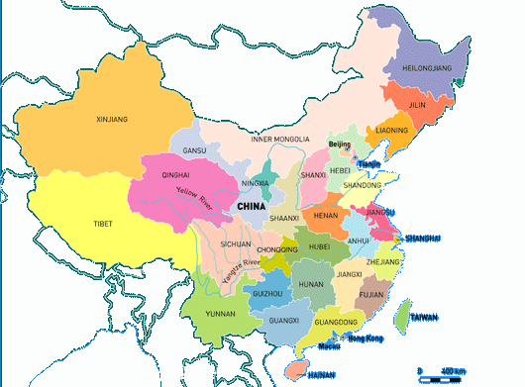
China - Five Distinct Opportunity Segments
Affluent Coastal regions: e.g., JiangSu, FuJian, GuangDong, …
Second Tier Cities: e.g., LuoYang, WeiFeng, ZiGong, …
Emerging “Western” provinces: e.g., SiChuan, ChongQing, JiLin, HLJ, …
Undeveloped provinces: e.g., GuiZhou, YuNan, GanSu, …

Slide 33
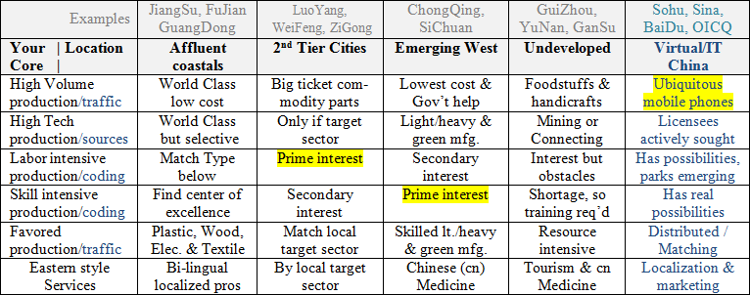
China Sourcing Template

Slide 34
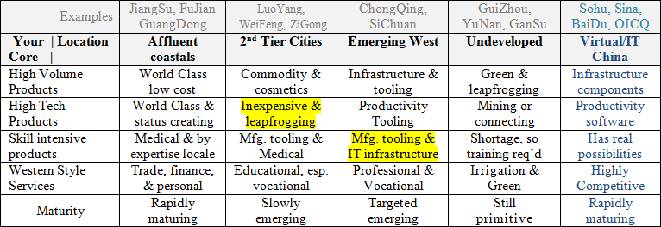
China Selling Template

